Slide 1
Kafka Streams & KSQL
Milco Numan

Slide 2
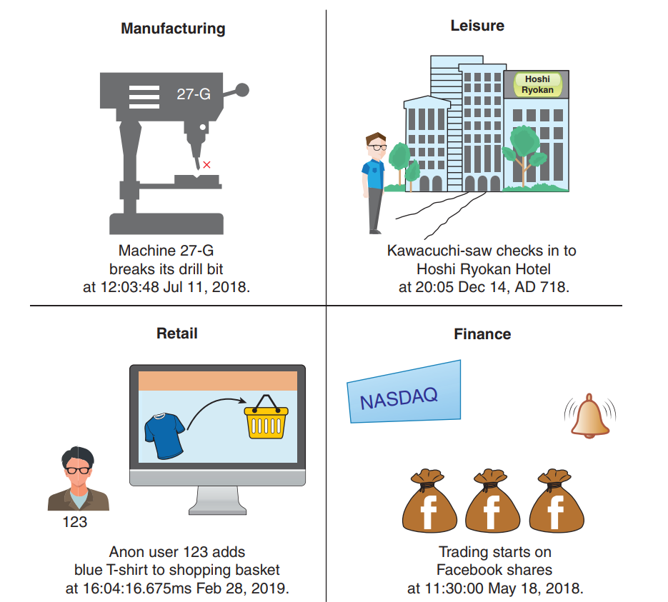
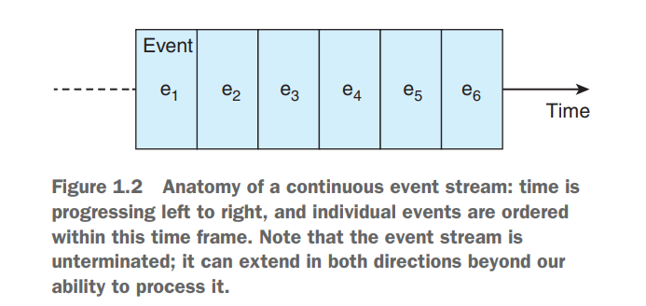
Events & Event Streams
“Iets wat we kunnen waarnemen en op een bepaald punt in de tijd plaatsvindt”
(Event Streams in Action)
Event Stream

Slide 3
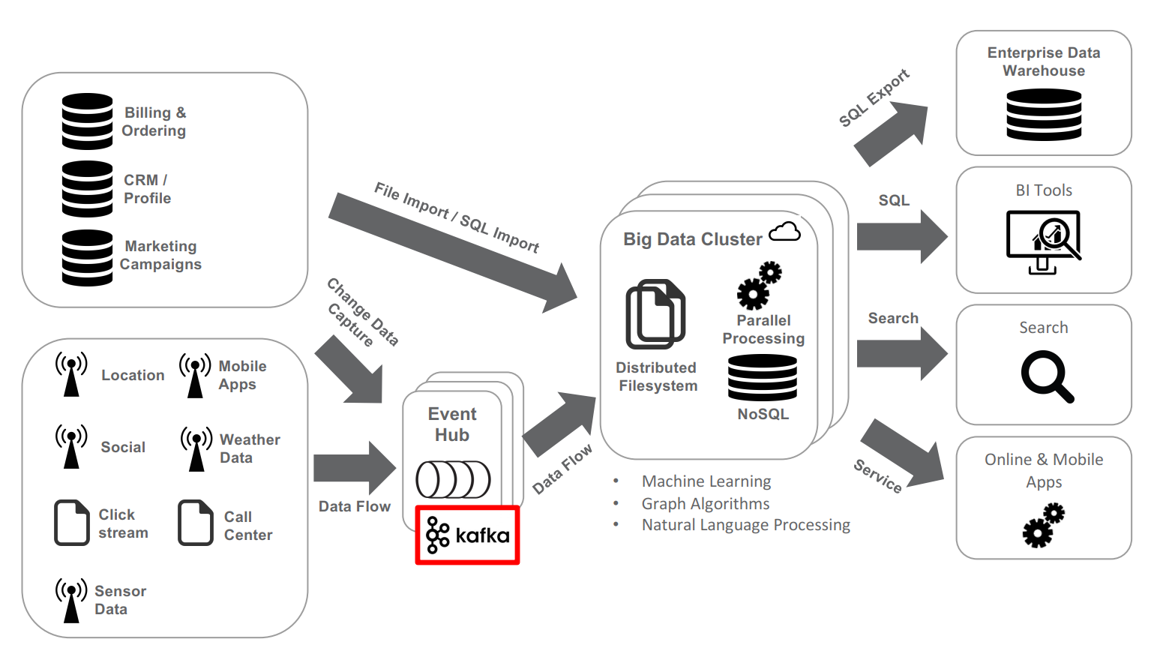
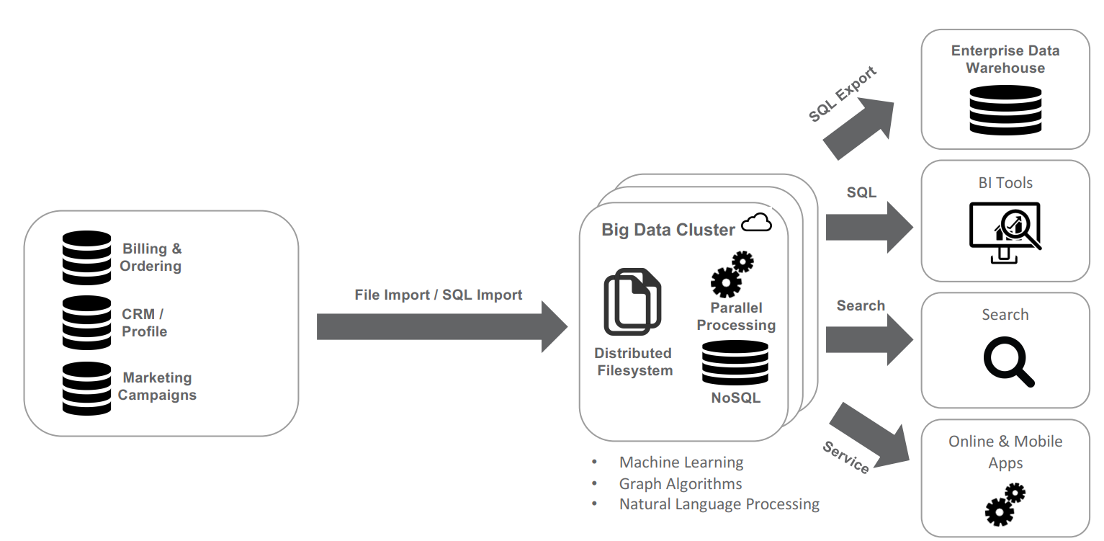

Big Data

Slide 4
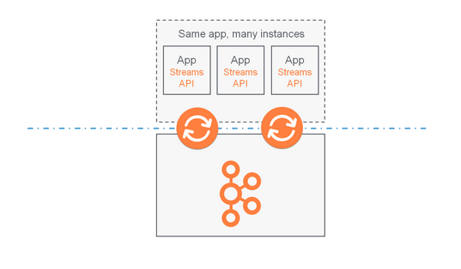
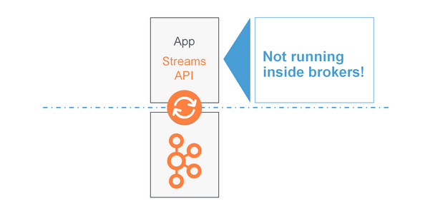
Kafka Streams API
“Simple & lightweight” library in Apache Kafka
Uitsluitend gebaseerd op Apache Kafka
Event-at-a-time (géén microbatch)
Windowing mogelijkheid
Niet in broker JVM, separate JVM

Slide 5
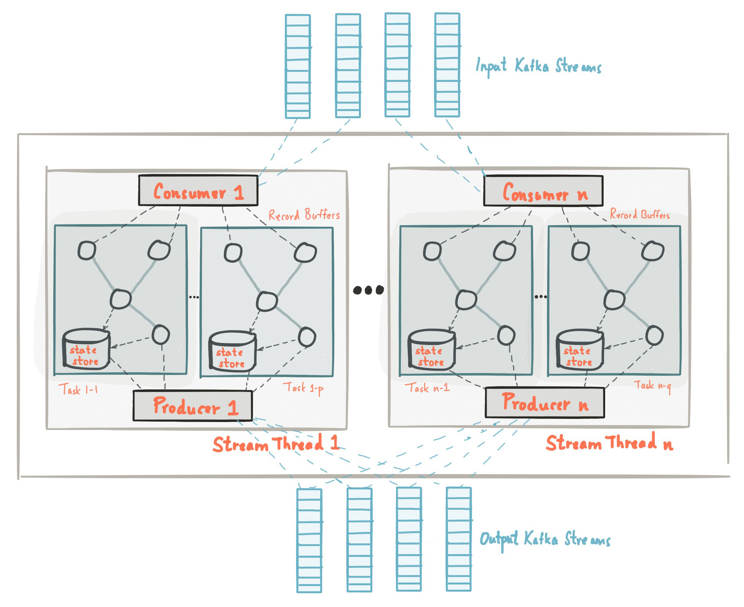
Kafka Streams Applications

Slide 6
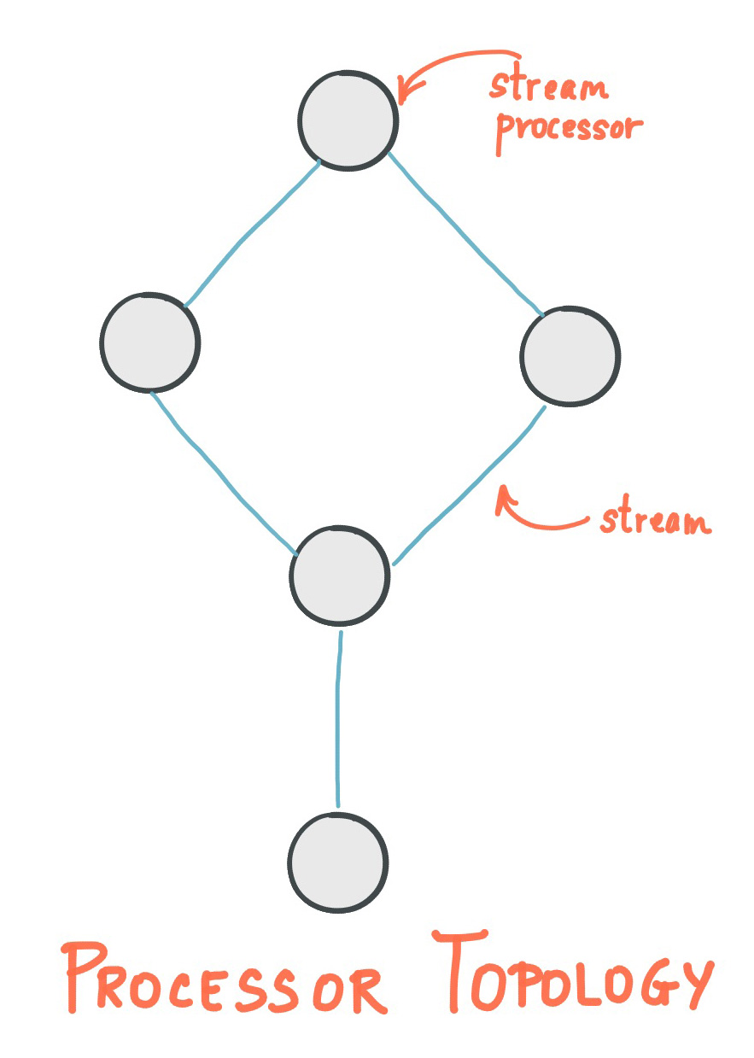
Processor API (low-level)
public class WordCountProcessor implements Processor<String, String> {
private ProcessorContext context;
private KeyValueStore<String, Long> kvStore;
@Override
@SuppressWarnings("unchecked")
public void init(ProcessorContext context) {
this.context = context;
kvStore = (KeyValueStore) context.getStateStore("Counts");
this.context.schedule(Duration.ofSeconds(1), PunctuationType.STREAM_TIME, (timestamp) -> {
KeyValueIterator<String, Long> iter = this.kvStore.all();
while (iter.hasNext()) {
KeyValue<String, Long> entry = iter.next();
context.forward(entry.key, entry.value.toString());
}
iter.close();
context.commit();
});
}
...

Slide 7
Streams DSL – builds on primitives
import org.apache.kafka.common.serialization.Serdes;
import org.apache.kafka.streams.StreamsBuilder;
import org.apache.kafka.streams.kstream.KStream;
StreamsBuilder builder = new StreamsBuilder();
KStream<byte[], String> stream = builder.stream(
"some-daft-input-topic",
Consumed.with(
Serdes.ByteArraySerde(),
Serdes.String()
);
// Java 8+: Lambda expression
KStream<String, Integer> transformed = stream.map(
(key, value) -> KeyValue.pair(value.toLowerCase(), value.length()));

Slide 8
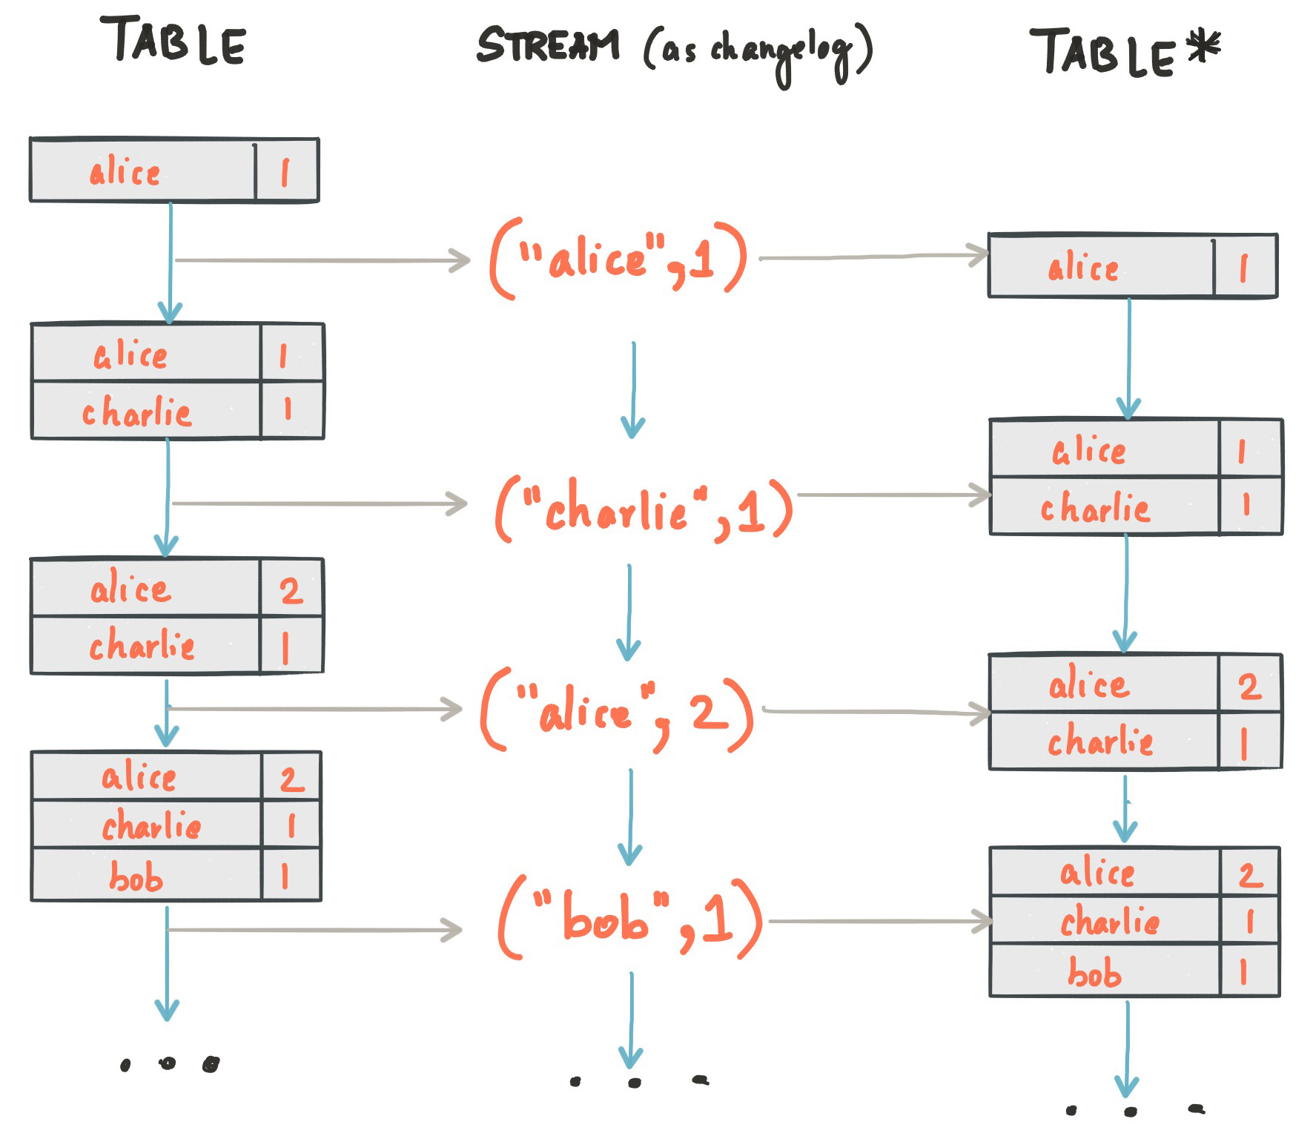
Stream-table duality
Stream = changelog of table
Table = snapshot of stream

Slide 9
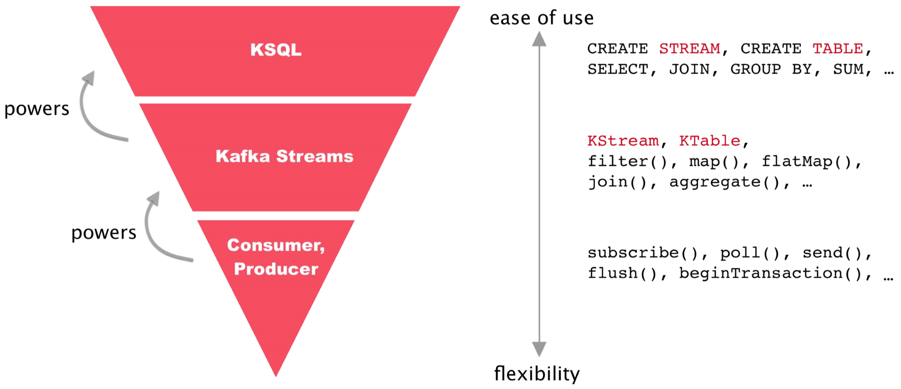
Introducing KSQL …

Slide 10
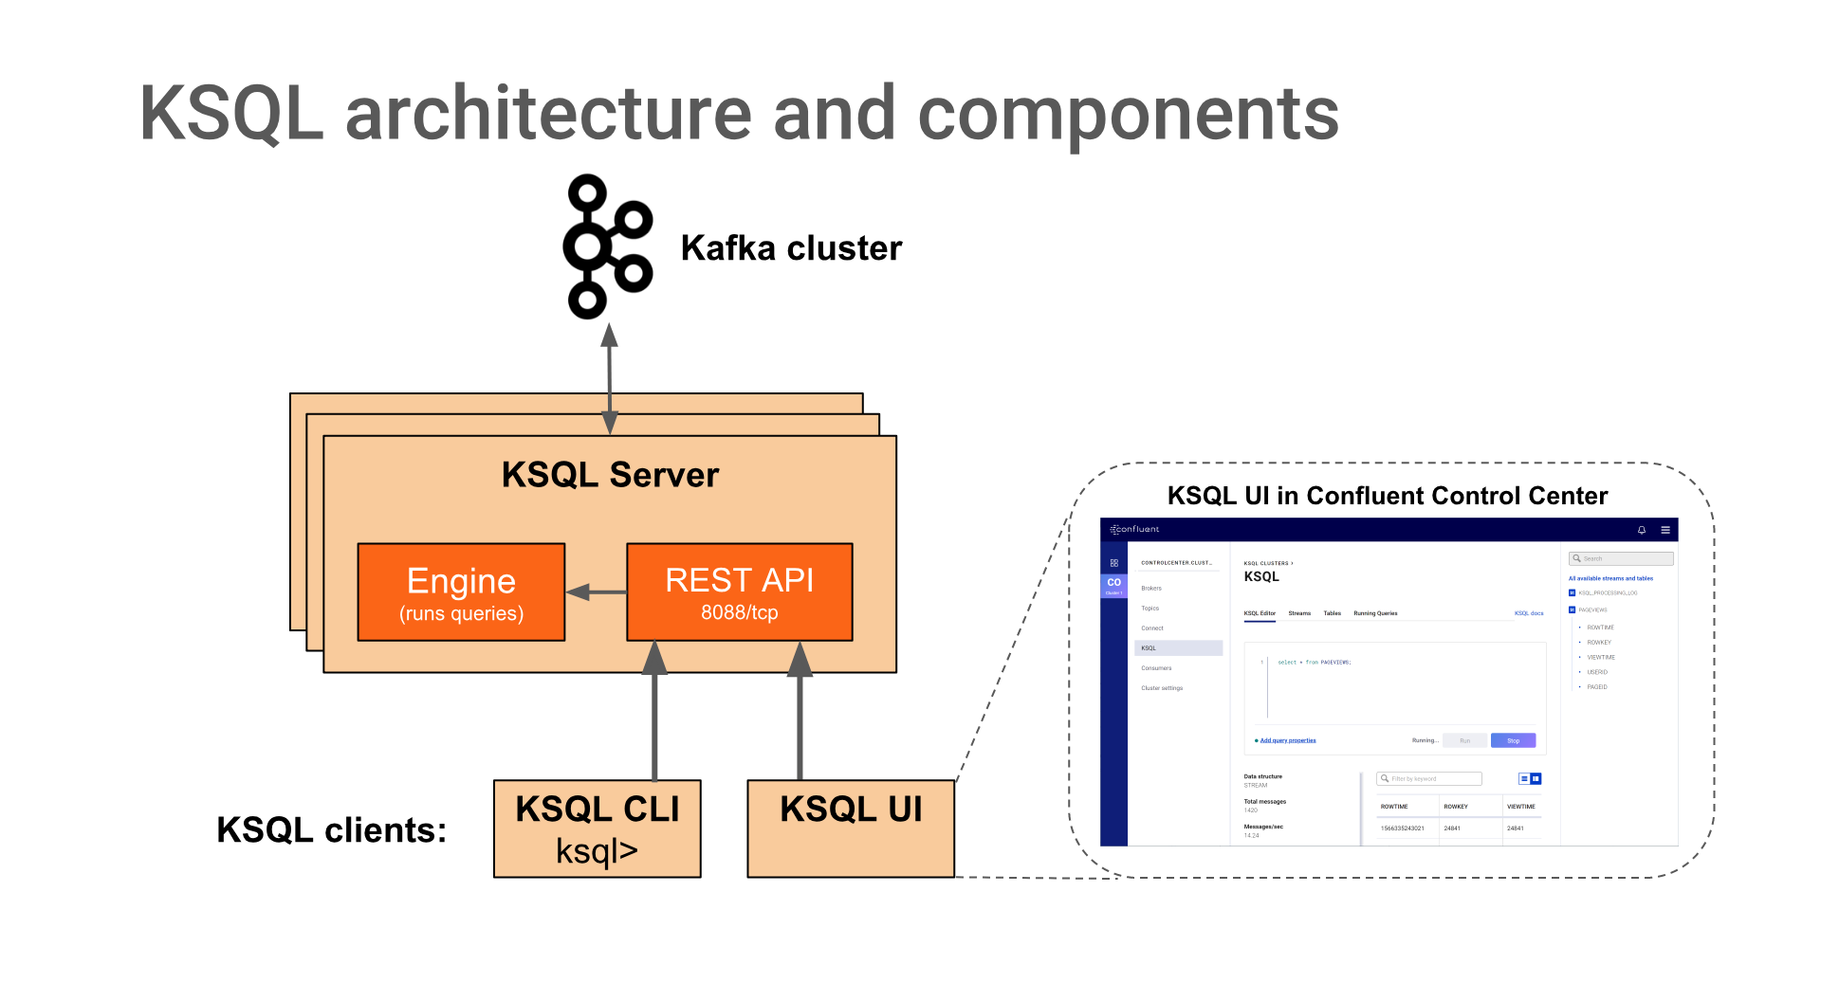
KSQL Architectuur

Slide 11
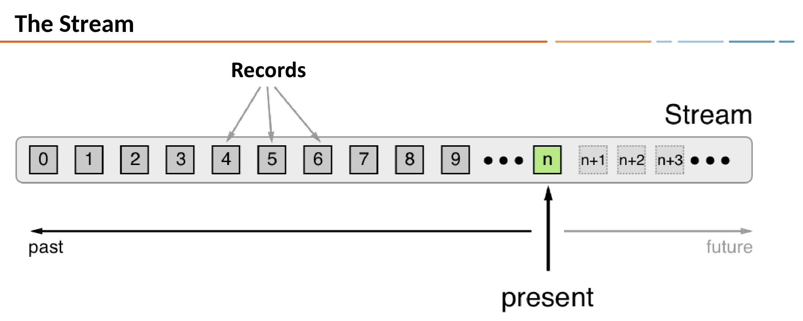
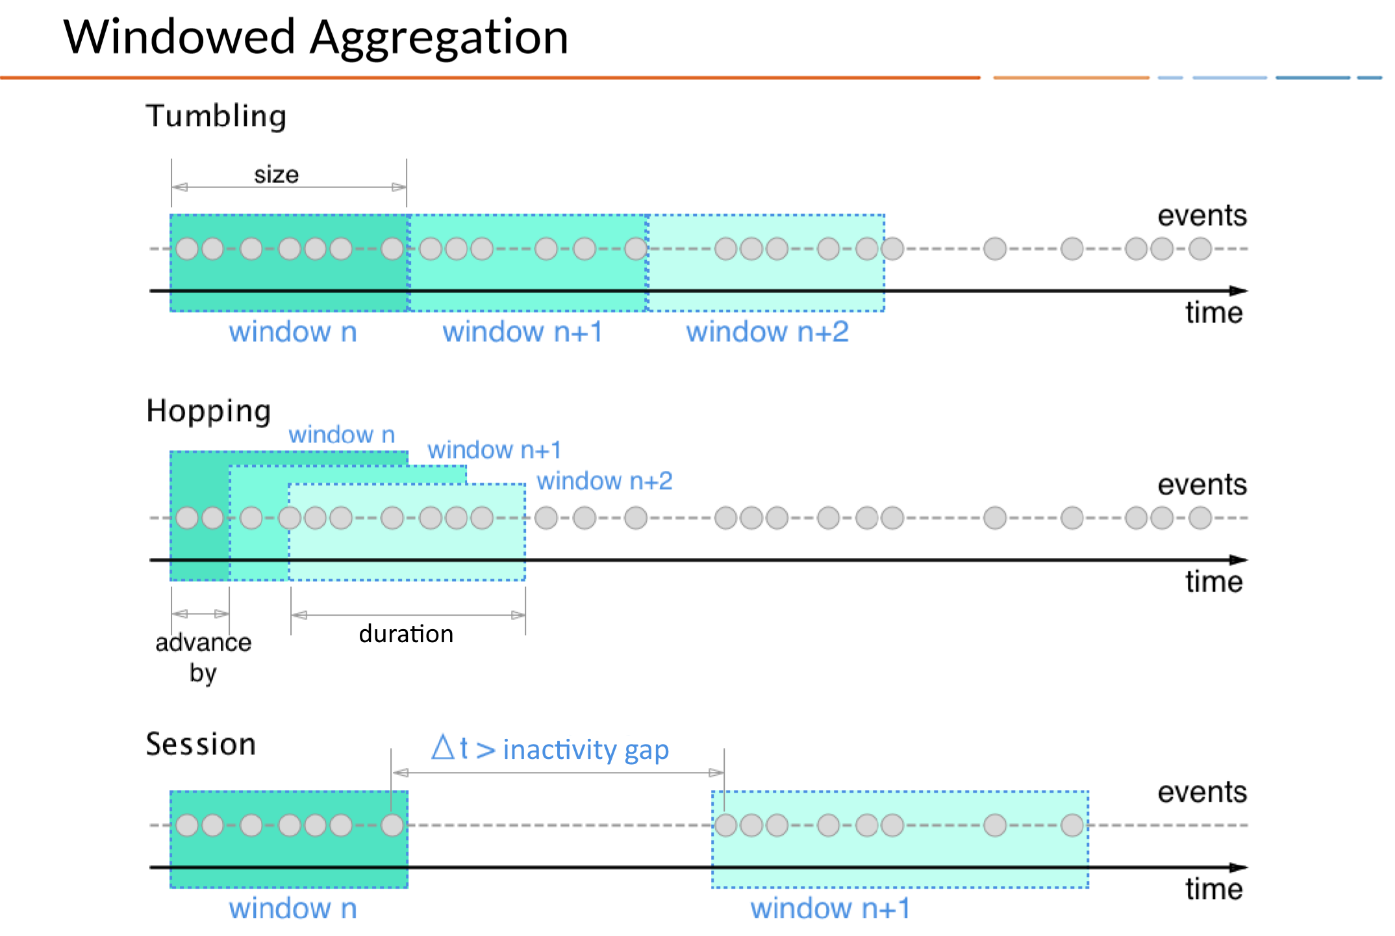

Slide 12
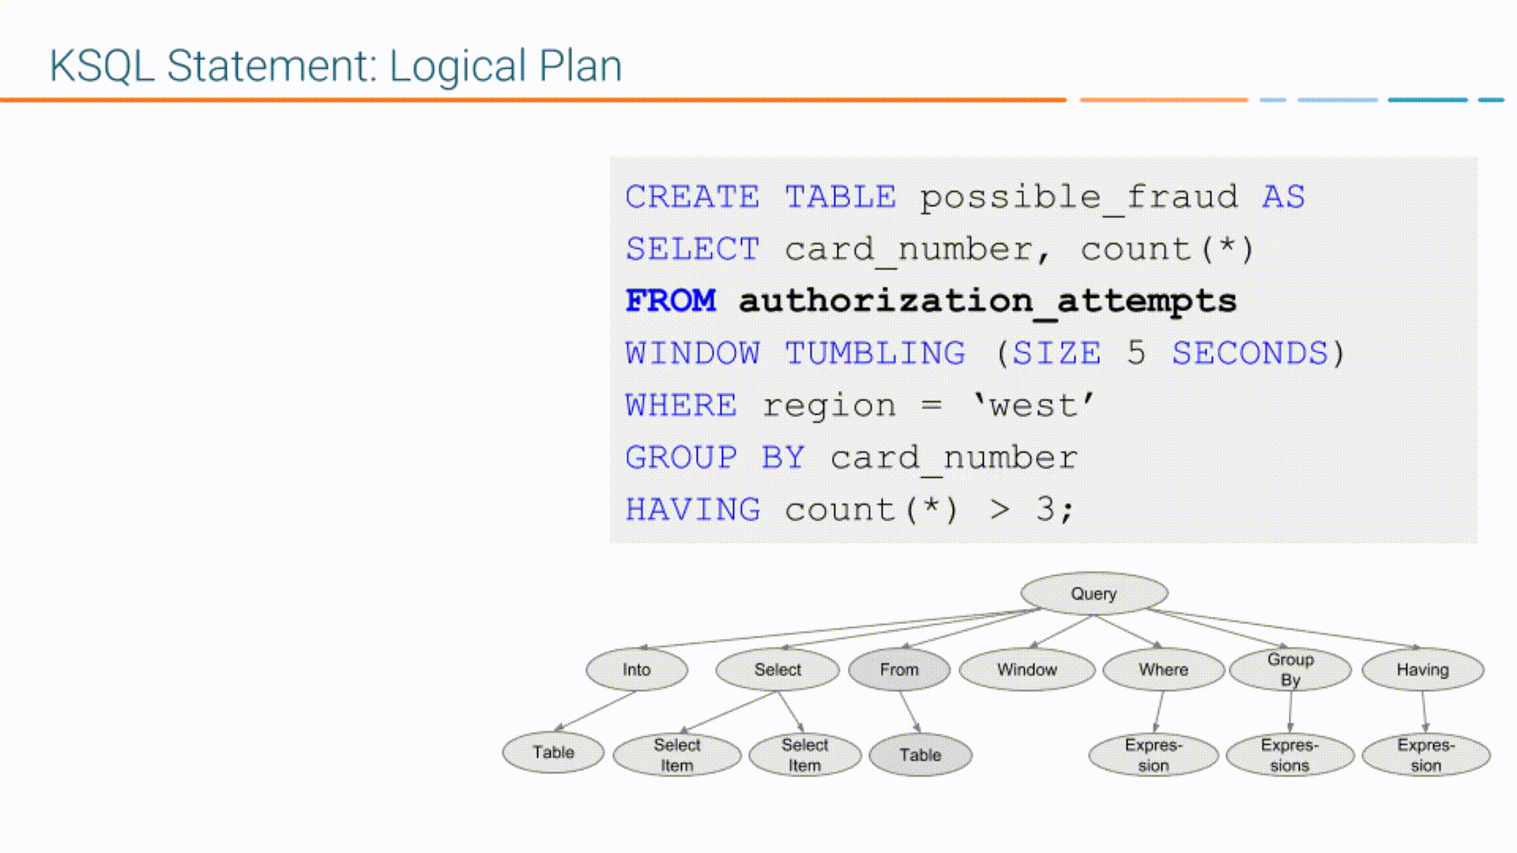
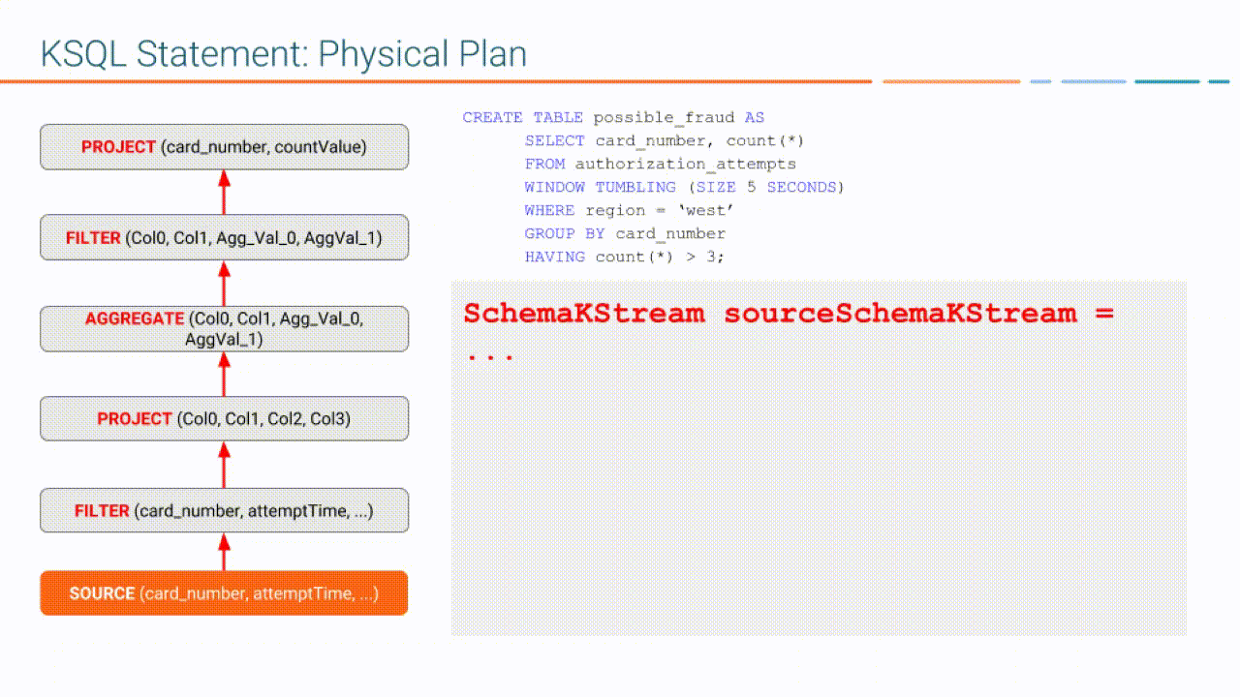
KSQL statements

Slide 13
KSQL – wat kun je ermee?
Create STREAM|TABLE [AS SELECT]
Scalar Functions
Data Masking
Conversion
String Manipulation
Aggregation (COUNT, SUM, TOPKDISTINCT, HISTOGRAM)
Joins
Custom functions (some Java dev required):
UDF – stateless scalar function
UDAF – stateful aggregate function

Slide 14
Resources
https://www.confluent.io/stream-processing-cookbook/
Documentation on:
Apache Kafka website
Confluent website
Bergen ander materiaal (https://lmgtfy.com/?q=kafka)
Gratis O’Reilly boeken over Kafka/Streams/Logs (opgenomen in de GitHub repository)

Slide 15
Hands-on
Kafka Streams Basics (https://bit.ly/2kxicWd)
vingeroefeningen met statische data
Kafka Streams Beer (https://bit.ly/2kcKSDw)
Bierbeoordelingen als Kafka events!
Tabel! (Statische referentie data)
Joins!
Filters!
Aggregaties!
IPAs!

Slide 16

Eindhoven
De Zaale 11
5612 AJ Eindhoven
Netherlands
Utrecht
Blok D, Graadt van Roggenweg 328-334
3531 AH Utrecht
Netherlands
info@syntouch.nl
www.syntouch.nl

